Slide 1
Placement Information System
Team Members Project Supervisor
Vinay Gupta (2100290140148) (Dr. Akash Rajak)
Prashant GUPTA (2100290140104)
Shubham Dubey (2100290140132)
Nishant Sharma (2100290140098)

Slide 2

Introduction
The placement information system project is developing an online application for the placement department of the college. This maintains and controls the training and placement details and does online operations and generates various reports. This system allows multidivisional, handling that includes various activities.
There are mainly three modules in this system:
Student Module
Faculty Module
Admin Module

Slide 3

TECHNOLOGIES / SOFTWARE REQUIREMENT
Windows, Linux, Mac operating system
Code Editor :VS code
Frontend: HTML, CSS, JAVASCRIPT
Backend: PHP
This Photo by Unknown Author is licensed under CC BY

Slide 4

MINIMUM HARDWARE REQUIREMENTS / HARDWARE USED
Intel i3 or above
4GB RAM or above
1.6Ghz speed or above
Hard-drive capacity 64GB or above

Slide 5

MODULES
There are mainly three modules in this system:
Student Module
Faculty Module
Admin Module

Slide 6
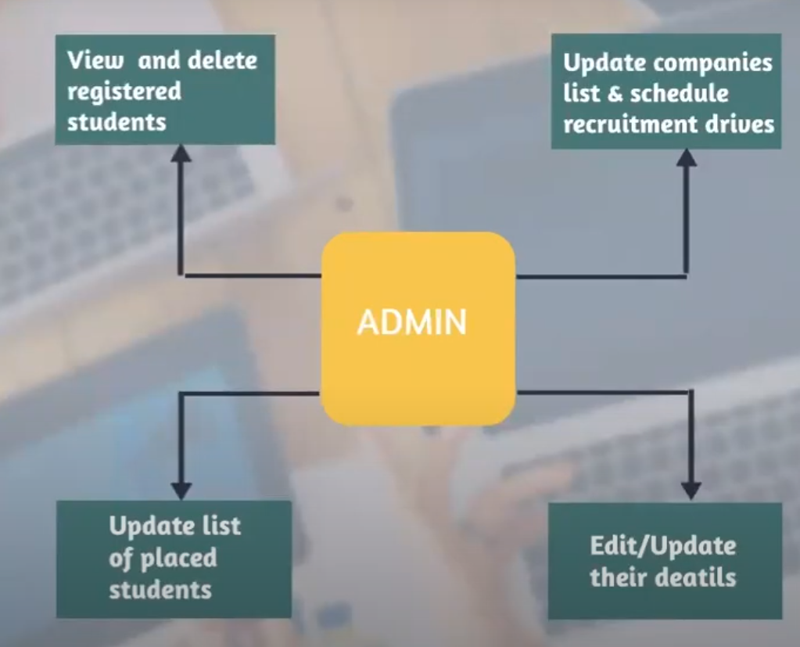
Admin module
Once the admin logins, they’ll be able to view and delete the registered students.
They updates the list of companies available for recruitment and also updates the schedule for various recruitment drives.
Admin will be able to update the student database with the list of students placed in various companies and their details.
The Admin maintains all the students who registered to the placements. And also maintains the details of the students who are eligible to which company placements.
Bootstrap,

Slide 7
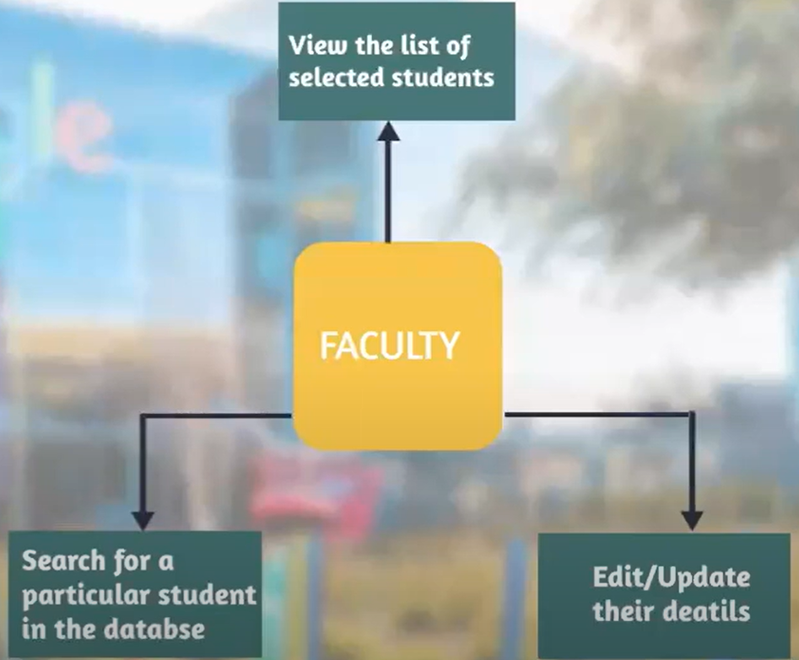
Faculty module
Once the faculty logins, they should be able to view the list of placed students and their details.
They will be able to perform the search operation for a particular student details in the student database.

Slide 8
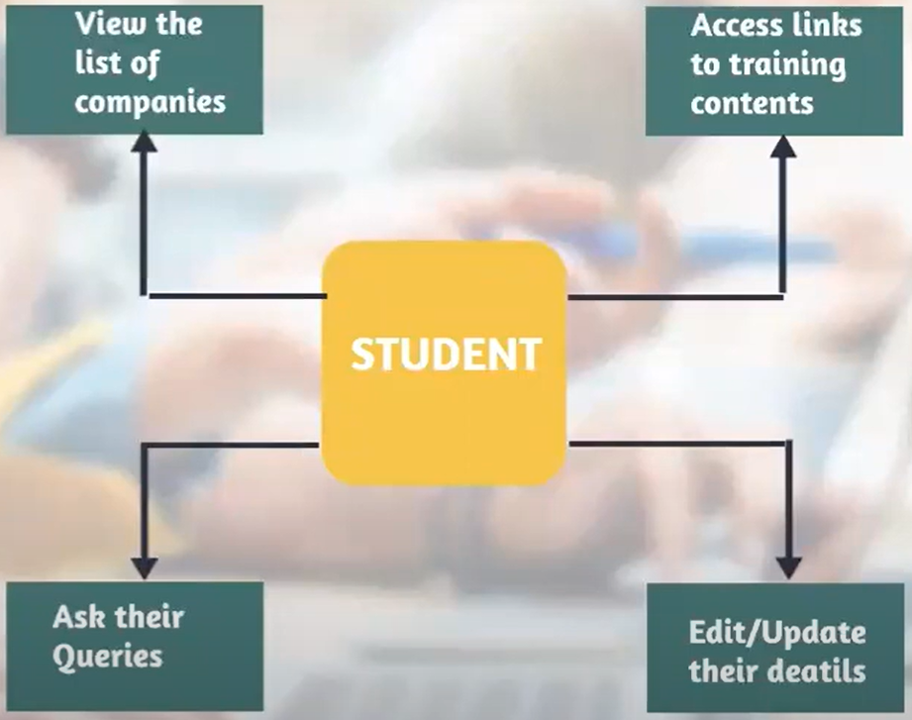
Student Module
After login, the student should be able to view the list of companies open for recruitment and the schedule of various recruitment drives.
They should be able to go to the training webpage and access links for various training courses and send their queries to admin.

Slide 9

Output
Use of this website is that makes it feasible for students to know about companies and makes it easy for placement team to know about student interests and who are willing to apply for a company and can also know about students through the marks provided by faculty. It also makes it easier to upload data related to companies, which decreases the effort to upload the data related to companies.

Slide 10

Conclusion
Placement information system manages student information in the college with regard to placement. It improves existing system. It has the facility of maintaining the details of the student, thereby reducing the manual work. It will save time and energy which are spending in making reports and collecting data.

Slide 11
GANTT CHART
 | WEEK 1 | WEEK 2 | WEEK 3 | WEEK 4 | WEEK 5 | WEEK 6 | WEEK 7 | WEEK 8 | WEEK 9 | WEEK 10 | WEEK 11 | WEEK 12
Requirement analysis and feasibility check
Designing
Coding
Testing and maintenance

Slide 12
Thank you

